Slide 1
Deep Learning
Next Generation Neural Networks Part 2
Tuesday 21st January
Dr. Nicholas Cummins

Slide 2

Outline of Lecture
Image Source: https://www.asimovinstitute.org/neural-network-zoo/
The Transformer Model
Efficient Inference Algorithms
Teacher Student Networks
Lottery Ticket Hypothesis
Generative Adversarial Networks
Variational Autoencoders
Explainable AI

Slide 3
Next Generation Neural Network
The Transformer Model
https://towardsdatascience.com/transformers-141e32e69591
https://medium.com/inside-machine-learning/what-is-atransformer-d07dd1fbec04
https://towardsdatascience.com/how-to-code-thetransformer-in-pytorch-24db27c8f9ec
https://arxiv.org/pdf/1706.03762.pdf
Notes:
http://jalammar.github.io/illustrated-transformer/
https://jalammar.github.io/visualizing-neural-machine-translation-mechanics-of-seq2seq-models-with-attention/

Slide 4
The Transformer Model
What is it?
A model for performing sequence-to-sequence learning without using Recurrent Neural Networks
Core Idea
When using RNNs it is not possible to process input sequences in parallel, this increases training time
Transformers are a combination of Convolutional Neural Networks (trivial to parallelise) with attention models

Slide 5
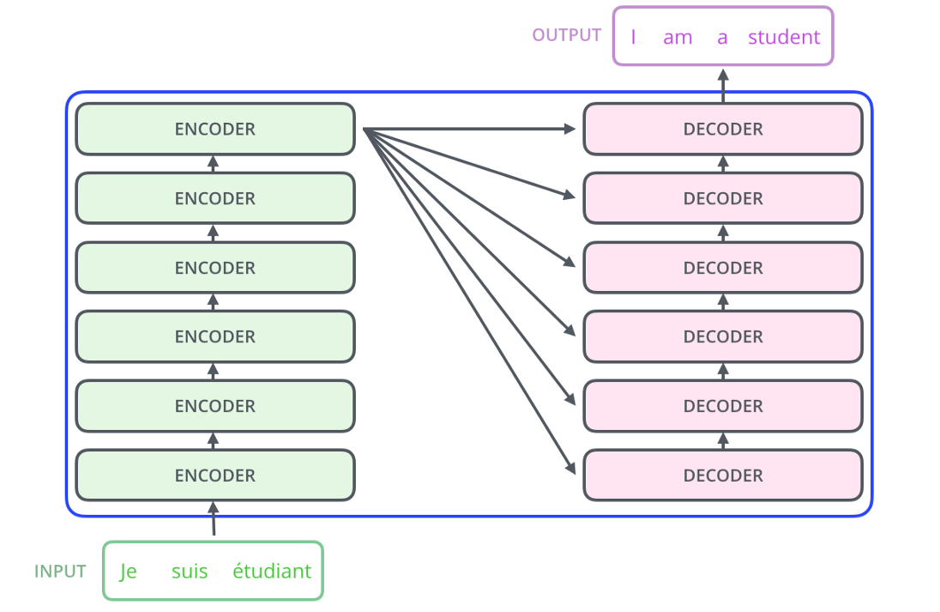
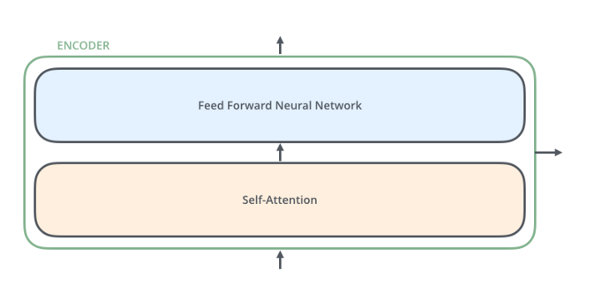
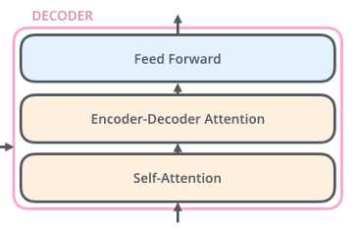
The Transformer Model
How does it work?
Encoder-decoder set-up: Internally a transformer has a similar set up to a RNN based sequence to sequence model
Encoder set-up: each encoder layer consist of self attention mechanisms and a feed forward network
Self attention captures importance of surrounding parts of input sequence when encoding
Decoder set-up: each encoder layer consist of Encoder-Decoder attention mechanisms and a feed forward network
Helps the decoder focus on relevant parts of the input sentence

Slide 6


The Transformer Model
Example use cases:
Transductive natural language processing
Machine Translation: producing sequences of words in a target language given examples in a source language.
Speech Recognition: producing sequences of text given sequences of audio.
Text-to-Speech: or speech synthesis, producing audio given text sequences

Slide 7

The Transformer Model
Advantages
Process inputs if parallel
Boost training speech
Train deeper models compared to using RNNs
Disadvantages
No longer performing sequential processing
Increases complexity of model
Need for large amounts of training data

Slide 8
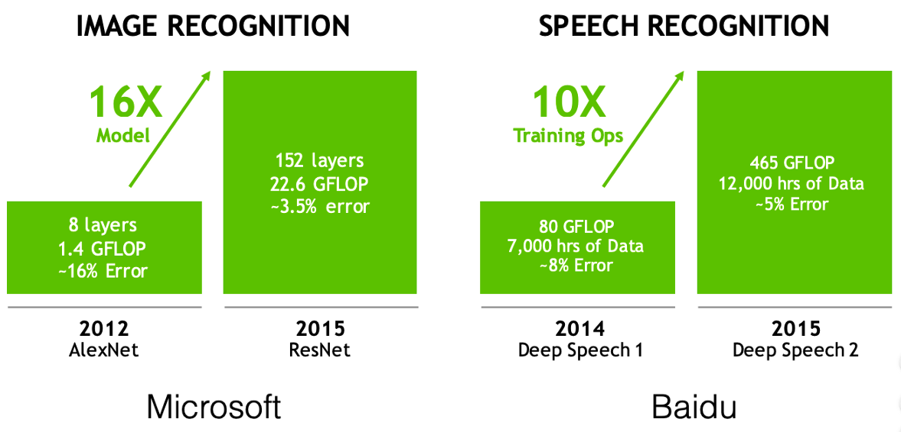
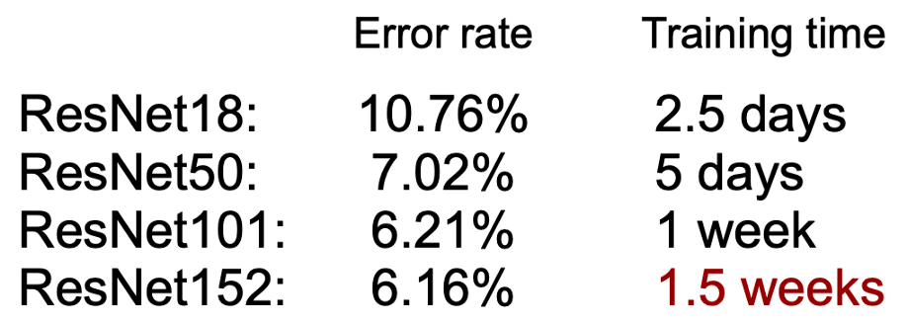
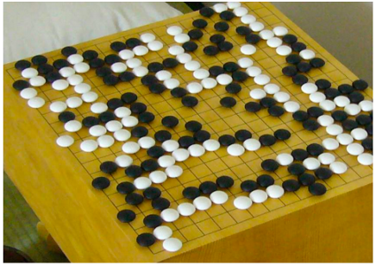
Compressing Deep Neural Networks
Efficient Inference Algorithms
Deep learning models are getting more and more accurate
This progress comes with a cost
Larger models
Longer training times
Decrease in energy efficiency
Getting smaller, faster and more efficient networks is important for running deep learning on mobile devices
AlphaGo: 1920 CPUs and 280 GPUs, $3000 electric bill per game

Slide 9
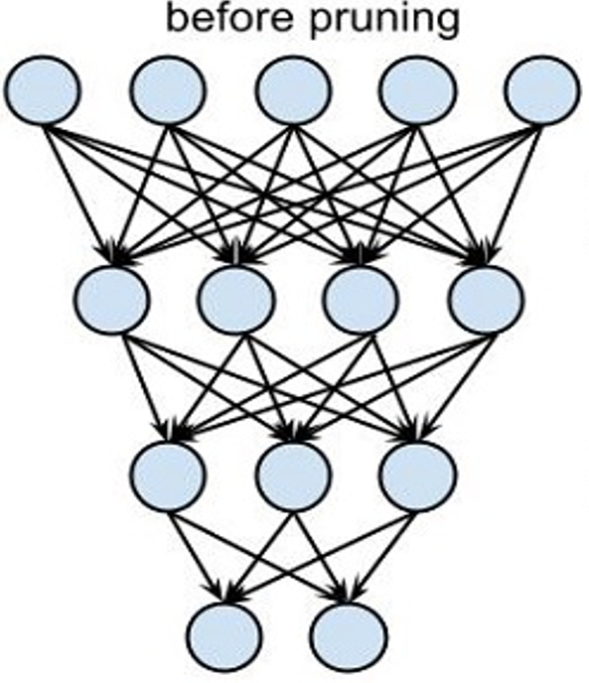
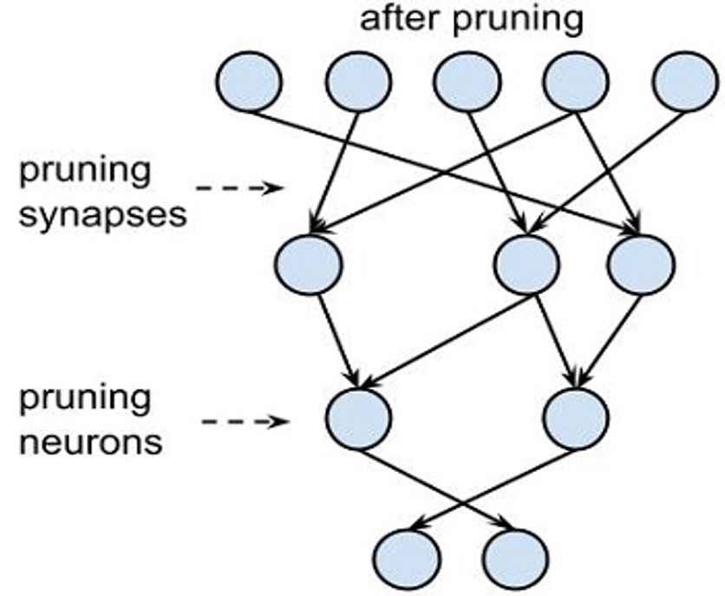
Compressing Deep Neural Networks
Pruning
Induce sparsity in a network’s connection matrices
Possible to remove 75-90% of neurons from a network without significantly affecting performance
Core idea:
Rank neurons according to how much they contribute
E.g., the L1/L2 norm of neuron weights
Remove the low ranking neurons from the network
This results a smaller and faster network

Slide 10
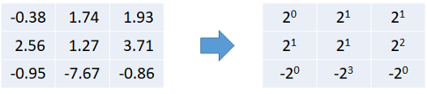
Compressing Deep Neural Networks
Quantization
Reducing the number of bits that represent a number
Predominant numerical format used for deep learning is the 32-bit floating point
Weights and activations can be represented using 8-bit integers without incurring significant loss in accuracy
Possible to reduce precision further
Binary Neural Networks {-1,1}
Ternary neural networks {-1,0,1}
Quantize to powers of Two

Slide 11
Next Generation Neural Networks
Teacher Student Networks
https://towardsdatascience.com/knowledge-distillation-simplified-dd4973dbc764
https://medium.com/neuralmachine/knowledge-distillation-dc241d7c2322
https://arxiv.org/pdf/1807.11158.pdf

Slide 12
Teacher Student Networks
What is it?
A training process for producing smaller neural networks
Core Idea
Teach a smaller network, step by step, exactly what to do using a bigger pre-trained network
Using output feature maps of the bigger network , the smaller network is trained to replicate the exact behaviour of the bigger network by learning to reproduce it’s outputs at every level

Slide 13
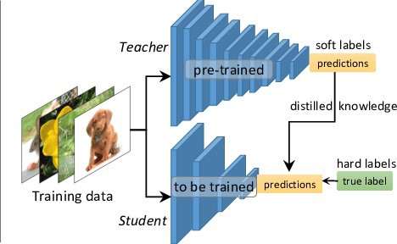
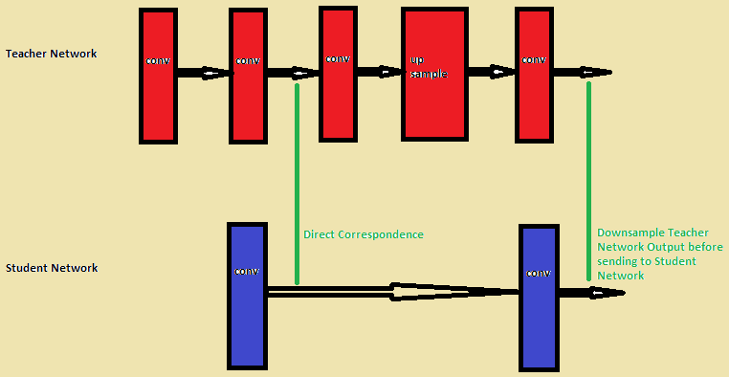
Teacher Student Networks
How does it work?
Train the Teacher Network: Train a highly complex teacher network
Establish Correspondence: Design the smaller student network by determining which layers outputs in the teacher model to pass to the student model
Forward Pass through the Teacher network: Pass data through the teacher network to get all required outputs
Backpropagation through the Student Network: use the outputs from the teacher network and correspondence relation to backpropagate error in the student network

Slide 14
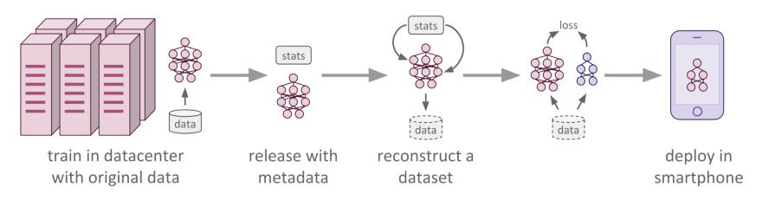
Teacher Student Networks
Uses Cases:
Take advantage of GPUs, large datasets to train a deep model highly suited to task at hand, and distil the learnt knowledge to a smaller network
Create neural networks for use in any device in which computing, memory, and power which are a bottleneck

Slide 15
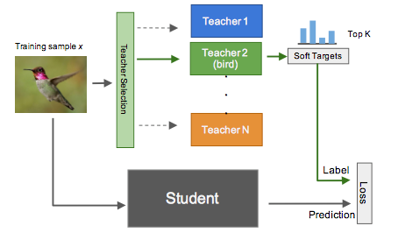
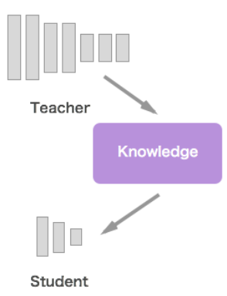
Teacher Student Networks
Advantages
Reduces likelihood of overfitting
Reduce model complexity whilst maintaining model performance
Correspondence based training has a regularising effect, it has higher entropy than binary based labels
Disadvantages
Increased training time
No guarantee the student network will converge at the same location as the teacher

Slide 16
Next Generation Neural Networks
Lotto Ticket Hypothesis
https://towardsdatascience.com/how-the-lottery-ticket-hypothesis-is-challenging-everything-we-knew-about-training-neural-networks-e56da4b0da27
https://towardsdatascience.com/breaking-down-the-lottery-ticket-hypothesis-ca1c053b3e58
https://arxiv.org/abs/1803.03635

Slide 17
Lottery Ticket Hypothesis
What is it?
A training process for producing smaller neural networks
Core Idea
The parameter count of a neural networks can reduced by over 90% without compromising accuracy
A large neural network will contain a smaller subnetwork that, if trained from the start, will achieve a similar accuracy than the larger structure

Slide 18
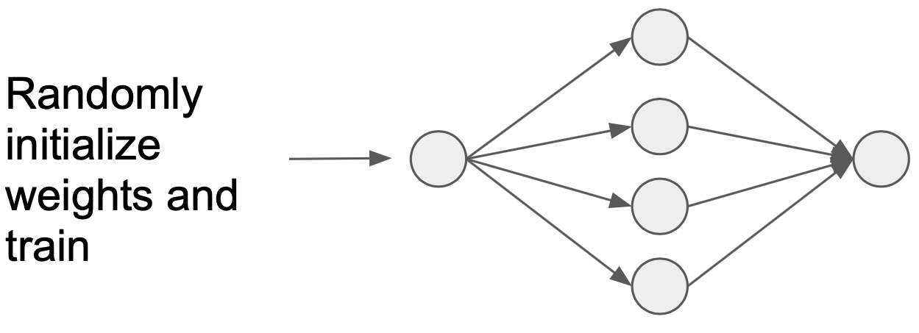
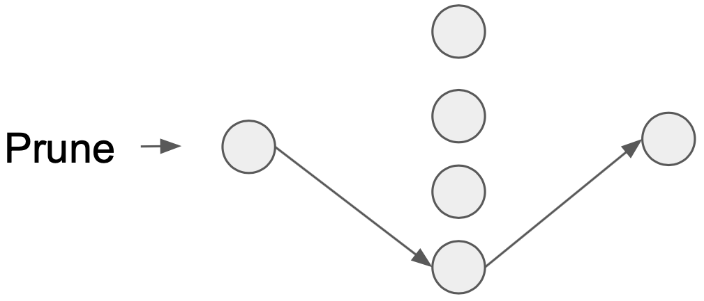
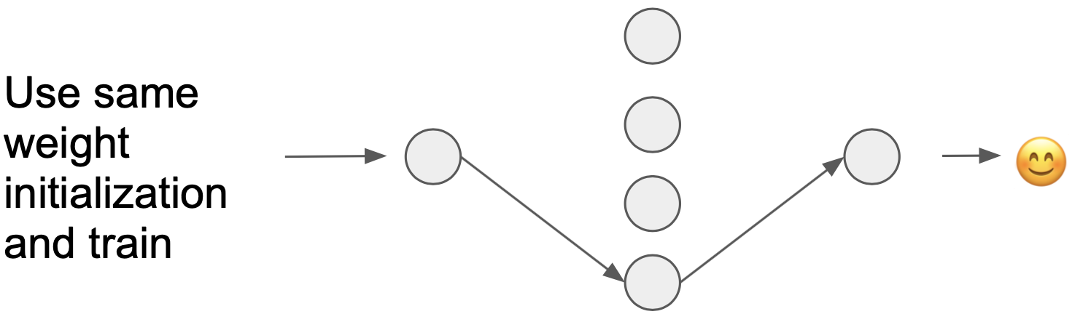
Lottery Ticket Hypothesis
How does it work?
Randomly initialize a neural network.
Train the network until it converges.
Prune a fraction of the network.
Reset the weights of the pruned network to their values from (1), i.e., their initial values before training
Re-train the pruned, untrained network and examine its convergence behaviour and accuracy.

Slide 19
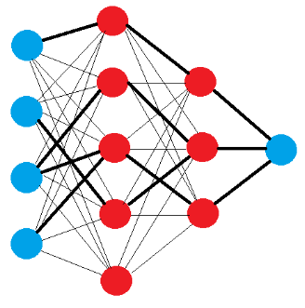
Lottery Ticket Hypothesis
Example uses cases:
Create neural networks for use in any device in which computing, memory, and power which are a bottleneck
E.g., Smartphones, IoT devices, etc
Advantageous in mHealth settings
Privacy a concern, having on device models minimise the transmission of sensitive data
Also reducing power consumption and bandwidth needs

Slide 20
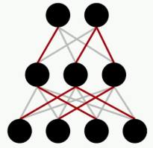
Lottery Ticket Hypothesis
Advantages
Networks with less parameters have decreased storage requirements and decreased inference time
Can result in a stronger performing network
Disadvantages
Considerably longer training time
No guarantees the winning ticket will be found
Train
Prune
Re-initialise
Re-train

Slide 21
Next Generation Neural Networks
Generative Adversarial Networks (GANs)
https://openai.com/blog/generative-models/
https://towardsdatascience.com/understanding-generative-adversarial-networks-gans-cd6e4651a29
https://medium.com/@jonathan_hui/gan-why-it-is-so-hard-to-train-generative-advisory-networks-819a86b3750b
https://arxiv.org/abs/1406.2661

Slide 22
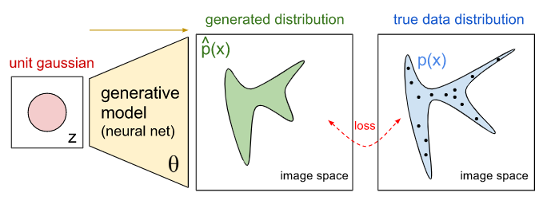
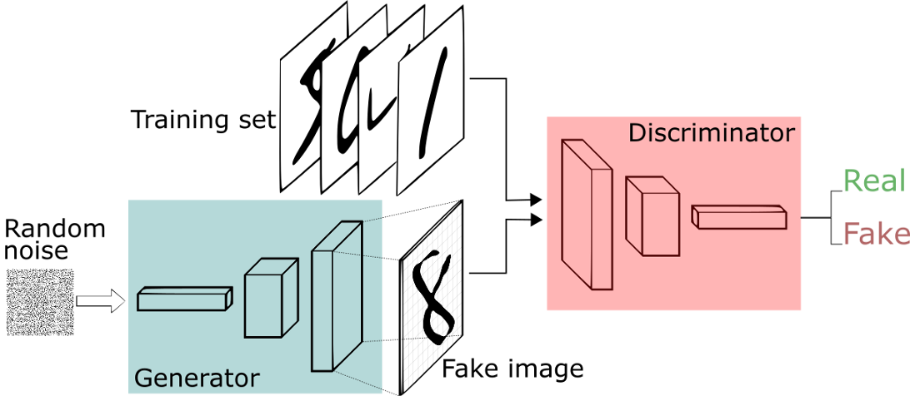
Generative Adversarial Networks
What is it?
A neural network paradigm that is able to generate new content for tasks such as data augmentation
Core Idea
Consists of a generator and discriminator networks playing a zero-sum game
Discriminator learns to differentiate between real and fake samples
Generator learning to fool discriminator by producing as realistic samples as possible
Game ends when discriminator cannot pick the difference between artificial and real data

Slide 23
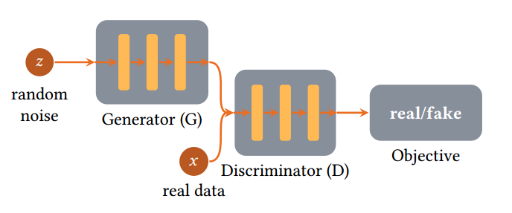
Generative Adversarial Networks
How does it work?
Maps noise sampled from a pre-defined distribution onto a training data distribution
Predict if a given sample is real or generated
Game ends when discriminator cannot pick the difference between artificial and real data
Generator learning to fool discriminator by producing as realistic samples as possible
Discriminator learns to differentiate between real and fake samples

Slide 24
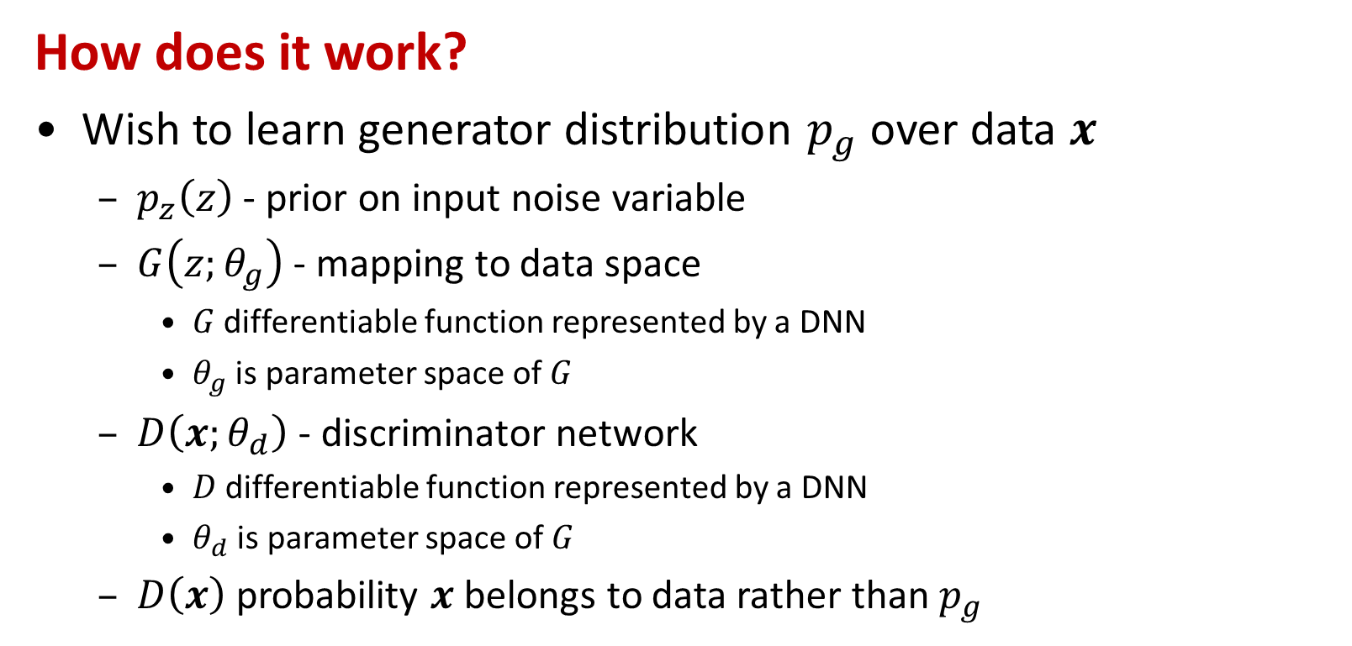
Generative Adversarial Networks
How does it work?
Wish to learn generator distribution $p_{g}$ over data $x$
$p_{z}\left(z\right)$ - prior on input noise variable
$G\left(z;θ_{g}\right)$ - mapping to data space
$G$ differentiable function represented by a DNN
$θ_{g}$ is parameter space of $G$
$D\left(x;θ_{d}\right)$ - discriminator network
$D$ differentiable function represented by a DNN
$θ_{d}$ is parameter space of $G$
$D\left(x\right)$ probability $x$ belongs to data rather than $p_{g}$

Slide 25
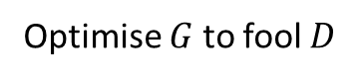
Generative Adversarial Networks
How does it work?
Discriminator loss function
Generator loss function
Loss function of two-player MinMax game is:
Recognise real samples better
Recognise generated samples better
$$\max_{D}{V\left(D\right)}={𝔼 }_{x\sim p_{data}\left(x\right)}\left[logD\left(x\right)\right]+{𝔼 }_{z\sim p_{z}\left(z\right)}\left[log\left(1−D\left(G\left(z\right)\right)\right)\right]$$
Optimise $G$ to fool $D$
$$\min_{G}{V\left(G\right)}={𝔼 }_{x\sim p_{z}\left(z\right)}\left[log\left(1−D\left(G\left(z\right)\right)\right)\right]$$
$$\min_{G}{\max_{D}{V\left(D,G\right)}}={𝔼 }_{x\sim p_{data}\left(x\right)}\left[logD\left(x\right)\right]+{𝔼 }_{z\sim p_{z}\left(z\right)}\left[log\left(1−D\left(G\left(z\right)\right)\right)\right]$$

Slide 26
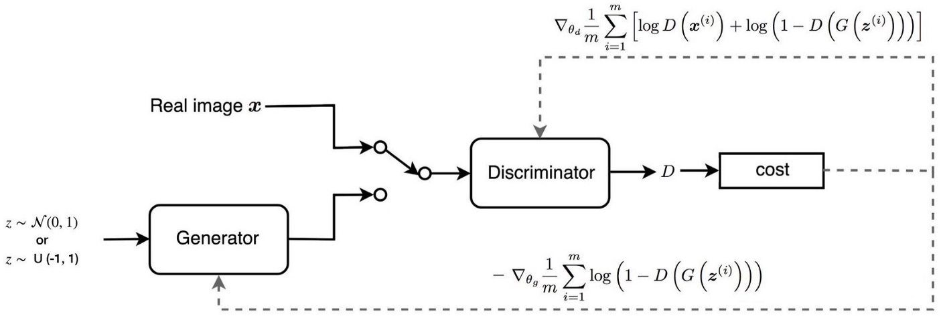
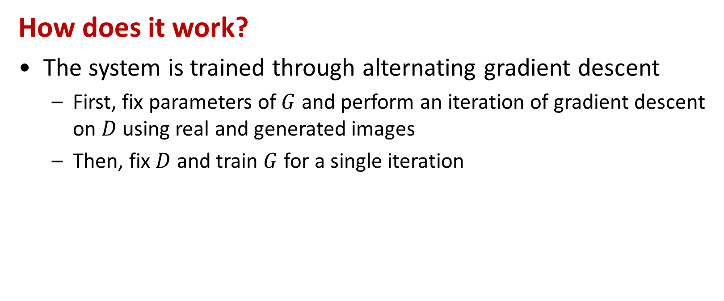
Generative Adversarial Networks
How does it work?
The system is trained through alternating gradient descent
First, fix parameters of $G$ and perform an iteration of gradient descent on $D$ using real and generated images
Then, fix $D$ and train $G$ for a single iteration

Slide 27
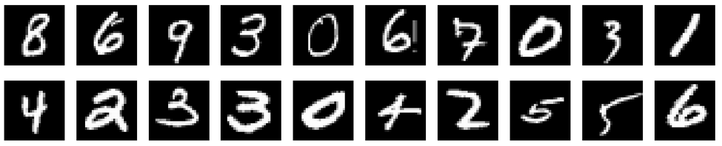
GAN Example Image Generation
MNIST Dataset
MNIST Dataset
http://yann.lecun.com/exdb/mnist/
Notes:
Eplain what MNIST is

Slide 28
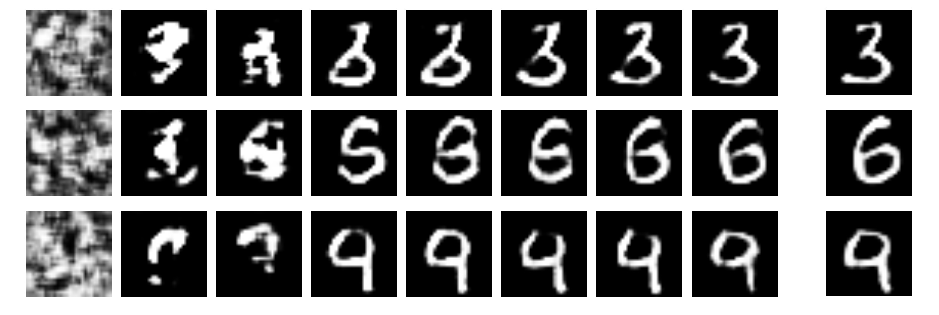
GAN Example: Image Generation
0 500 1000 1500 2000 2500 3000 3500 4000
Iterations
Notes:
Example DGAN generating handwritten Digits from 0-9. Starts off with noise vector as input..

Slide 29
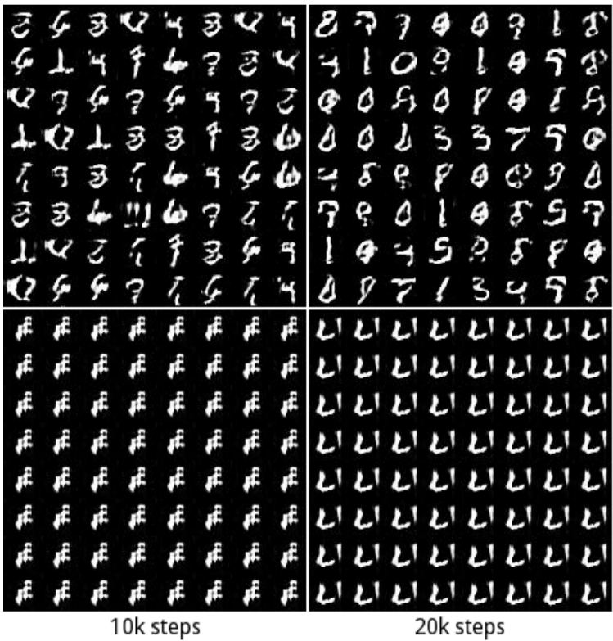
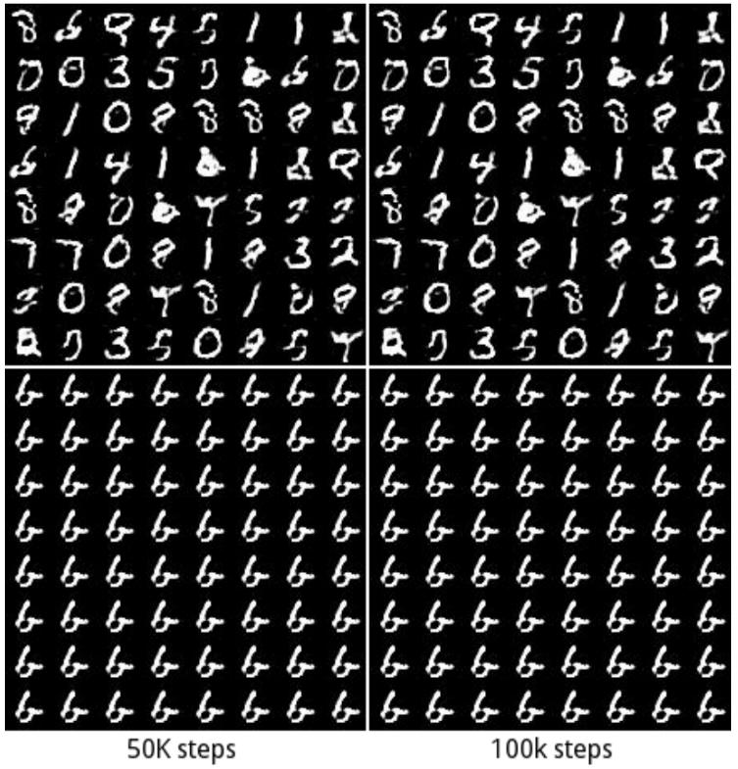
Generative Adversarial Networks
Advantages
Can generate realistic data samples
Disadvantages
Non-convergence: the model parameters oscillate, destabilize and never converge
Mode collapse: the generator collapses which produces limited varieties of samples
Diminished gradient: the discriminator gets too good that the generator gradient vanishes and learns nothing

Slide 30
Next Generation Neural Network
Variational Autoencoders
https://towardsdatascience.com/intuitively-understanding-variational-autoencoders-1bfe67eb5daf
https://towardsdatascience.com/understanding-variational-autoencoders-vaes-f70510919f73
http://kvfrans.com/variational-autoencoders-explained/
https://arxiv.org/abs/1606.05908

Slide 31
Variational Autoencoders
What is it?
Another method for generating data
Core Idea
Data is generated using an autoencoder structure as opposed to an adversarial setting
A probability distribution is learnt in the autoencoder latent space
Generating data is then a case of sampling from this learnt distribution and passing it through the decoder

Slide 32
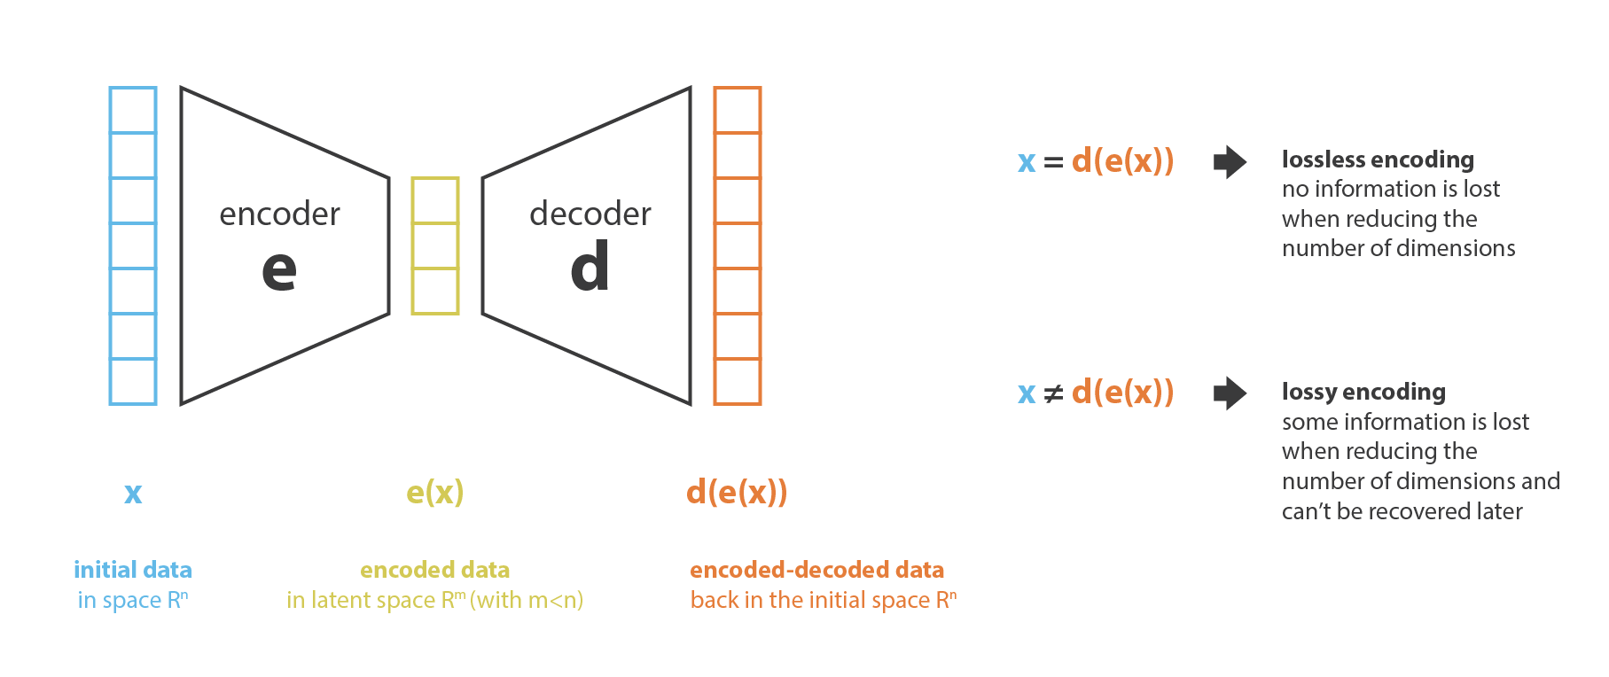
Variational Autoencoders
What is an Autoencoder?
A pair of connected networks, an encoder and a decoder
The encoder network takes in an input, and converts it into a smaller, dense representation know as the latent space
The decoder network can convert the latent back to the original input
An autoencoder is not a generative model, it learns the optimal latent space to reconstruct data

Slide 33
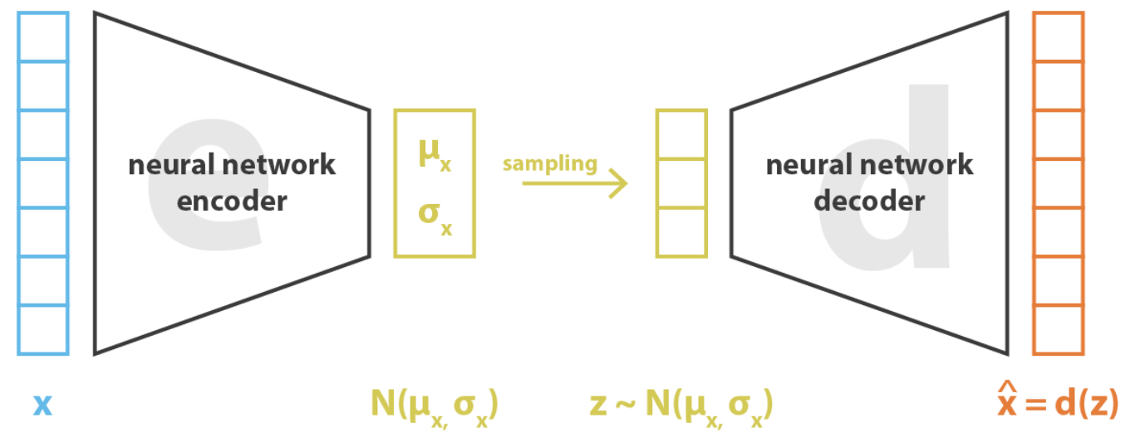
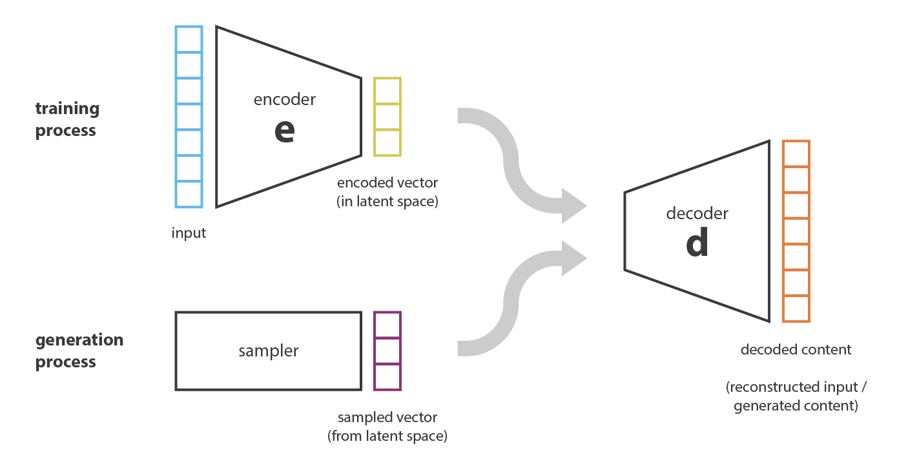
Variational Autoencoders
What is a Variational Autoencoder?
To generate data we add a constraint on the encoding network, that forces it to generate latent vectors that roughly follow a unit gaussian distribution
Generating data is then a case of sampling from this learnt distribution and passing it through the decoder
During training, the network must learn to trade-off accuracy vs. the how close the latent variables match the unit gaussian distribution

Slide 34
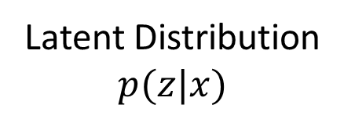
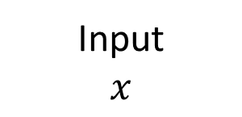
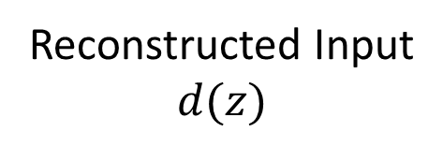
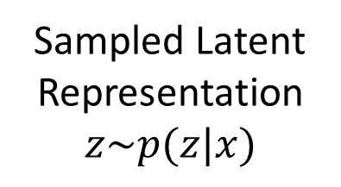
Variational Autoencoders
Input
$$x$$
How does it work?
The training process
The input is encoded as distribution over the latent space
A point from the latent space is sampled from that distribution
The sampled point is decoded and the reconstruction error can be computed
The reconstruction error is backpropagated through the network
Encoding
Latent Distribution
$$p(z|x)$$
Sampling
Sampled Latent Representation
$$z\sim p(z|x)$$
Decoding
Reconstructed Input
$$d(z)$$

Slide 35
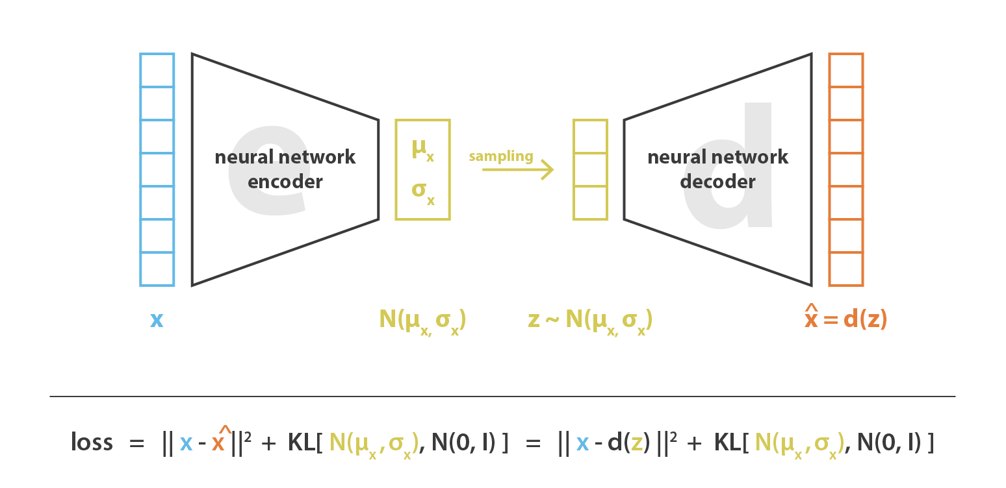
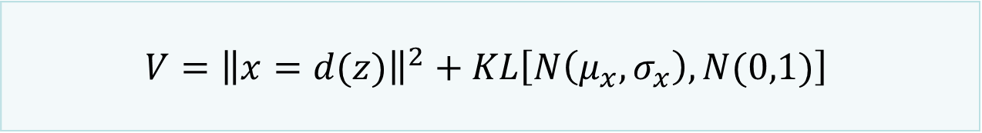
Variational Autoencoders
How does it work?
Loss function
Latent loss: which is the KL divergence that measures how closely the latent variables match a unit gaussian
Generative loss: which is a mean squared error that measures how accurately the network reconstructed the images
$$V={\left\|x=d(z)\right\|}^{2}+KL\left[N\left(μ_{x},σ_{x}\right),N(0,1)\right]$$

Slide 36
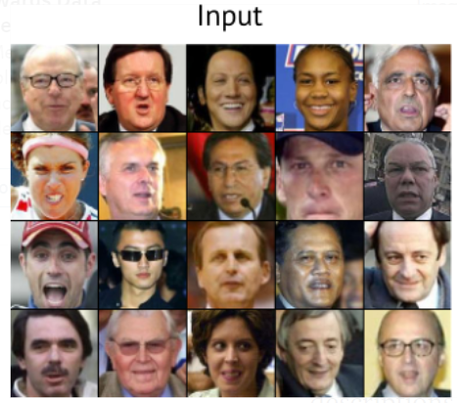
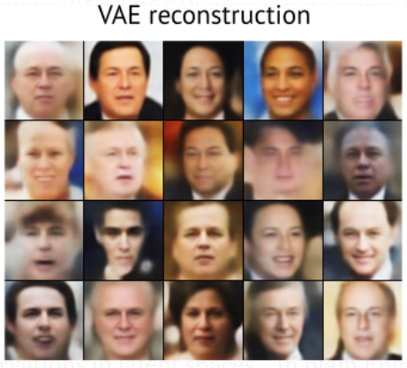
Variational Autoencoders
Advantages
Addresses main weakness of GANS
Disadvantages
No guarantees latent variables follow a Gaussian distribution
Can produce blurry images
Due to sampling from inappropriate distribution
Also related to the loss function

Slide 37
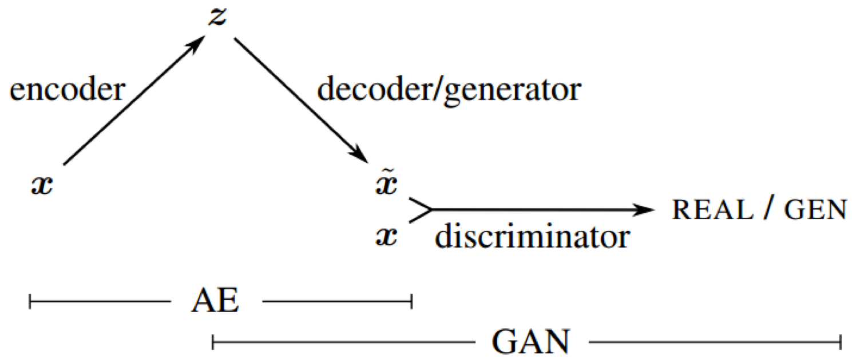
Next Generation Neural Network
The VAE-GAN
https://arxiv.org/abs/1512.09300
https://towardsdatascience.com/what-the-heck-are-vae-gans-17b86023588a

Slide 38
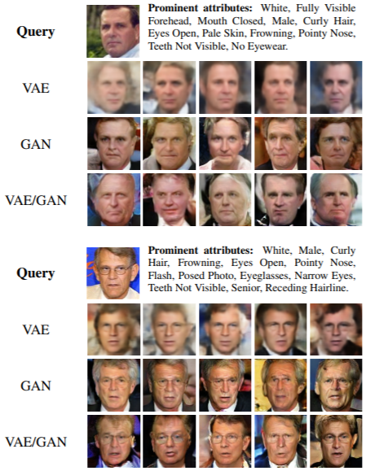
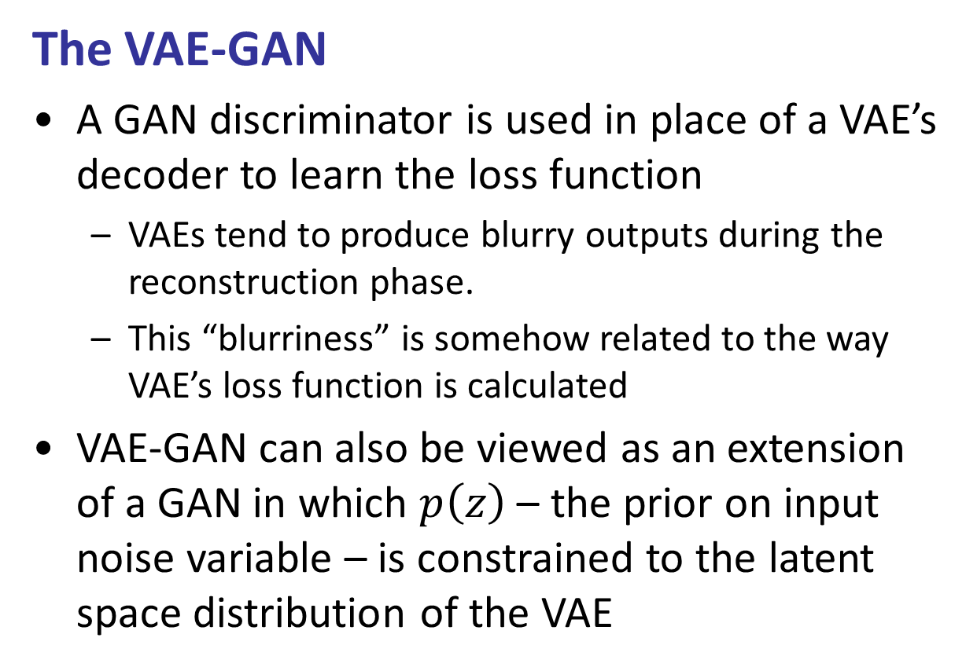
Next Generation Neural Network
The VAE-GAN
A GAN discriminator is used in place of a VAE’s decoder to learn the loss function
VAEs tend to produce blurry outputs during the reconstruction phase.
This “blurriness” is somehow related to the way VAE’s loss function is calculated
VAE-GAN can also be viewed as an extension of a GAN in which $p\left(z\right)$ – the prior on input noise variable – is constrained to the latent space distribution of the VAE

Slide 39
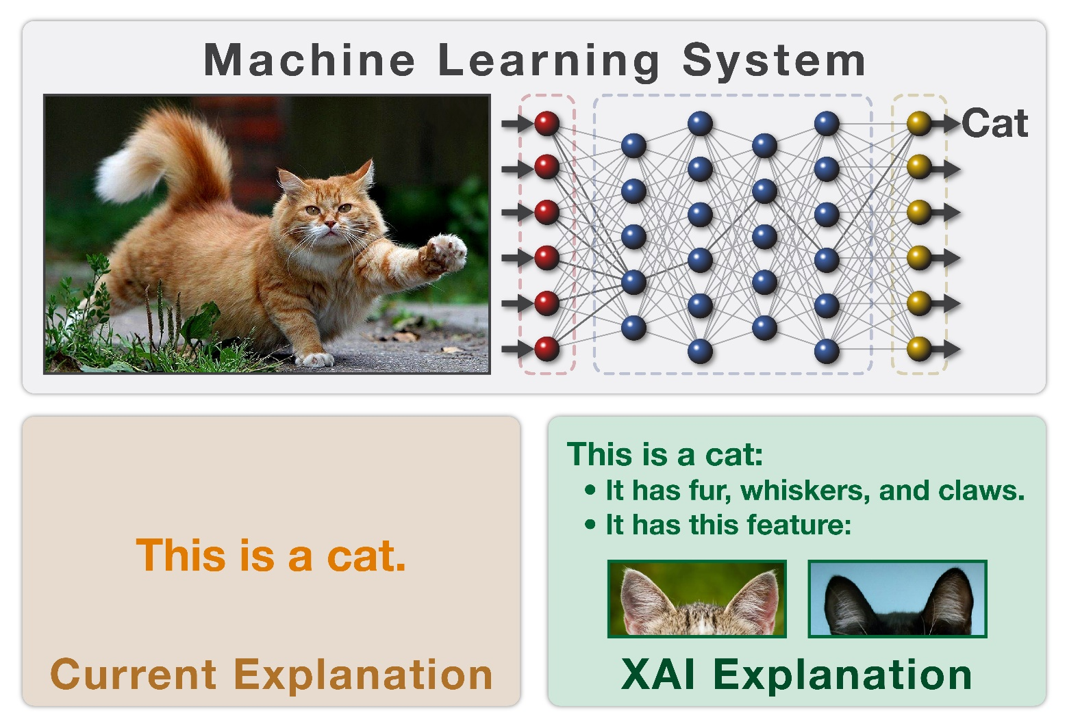
Next Generation Neural Network
XAI Material based on:
Molnar, Christoph. "Interpretable machine learning. A Guide for Making Black Box Models Explainable", 2019.
Explainable AI
Image Source:
https://connected-data.london/2017/09/18/explainable-ai-xai/

Slide 40
XAI Introduction
Machine Learning (ML) has great potential for aiding decision making, especially in healthcare settings
However, ML, much like humans, will take ‘short-cuts’ when learning from data
ML can be affected by biases inherent in training data
We therefore need increased explainability:
Understand the inner workings of ML systems
Learn both how and why a decision got made

Slide 41
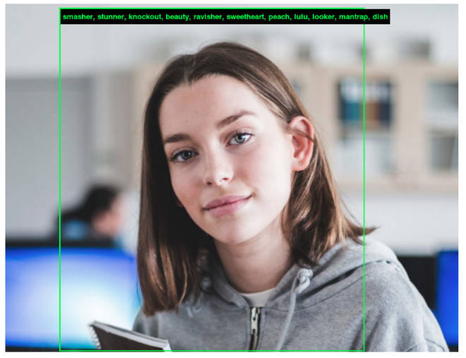
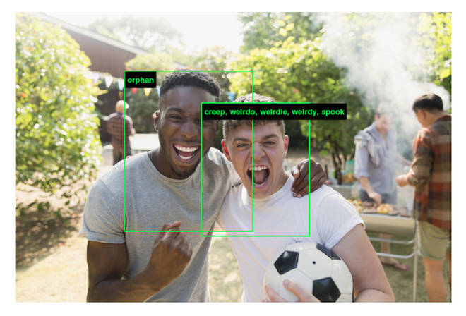
XAI Introduction
Image Source: https://www.popbuzz.com/
ImageNet Roulette
Classifier trained on images of faces and matching labels in the widely used ImageNet dataset
Labels used were obtain by using crowdsourcing
Labellers categorised what they saw in terms of race, gender, age, emotion, and often personal character traits
Classifier returned racist, misogynistic and cruel results

Slide 42

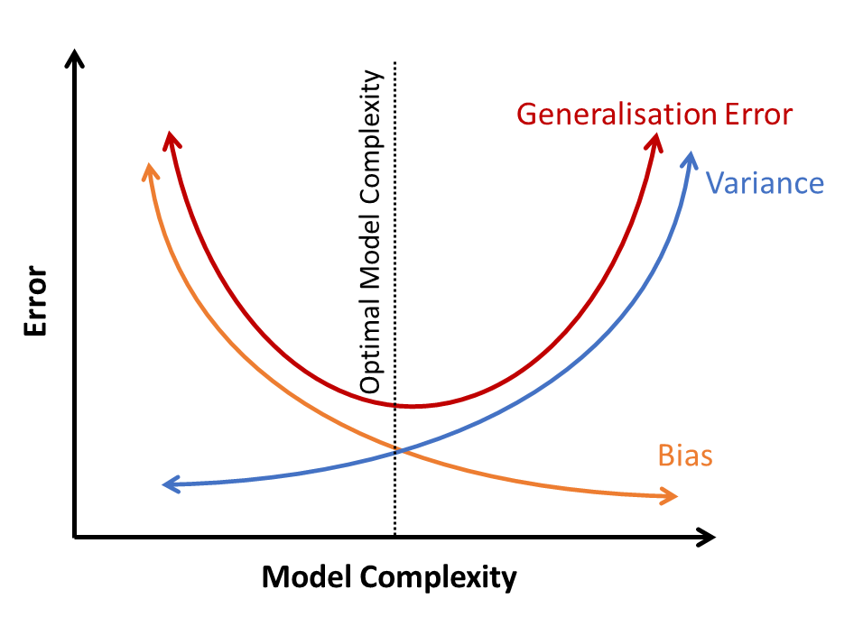
XAI Introduction
Image Source: http://www.arashfarahani.com/
Biases are not just associated with labels
Selection Bias
Under-representation of a particular group in the training data
E.g., a gender, age, socioeconomic status, racial or ethnic group
Modelling Bias
Bias and Variance Errors
Training an ill fitting model
High bias associated with underfitting
Increase model complexity

Slide 43
XAI Introduction
We need increased Explainability
The potential for biases to exist necessitates the need for an increase in explainable machine learning models
Under General Data Protection Regulation (GDPR) in the European Union, clinicians and patients have a right to understand how AI-driven decisions are made
Increased knowledge and understanding of internal operations and decisions should also improve the overall accuracy and generalisability

Slide 44


Overview
Image Source: https://www.linkedin.com
Definitions
Importance of Interpretability
Taxonomy of Methods
Interpretable Models
Model-Agnostic Methods
Example-based Explanations
Neural Network Interpretation
Where to next?

Slide 45
Overview
Image Source: https://www.linkedin.com
Definitions
Importance of Interpretability
Taxonomy of Methods
Interpretable Models
Model-Agnostic Methods
Example-based Explanations
Neural Network Interpretation
Where to next?

Slide 46
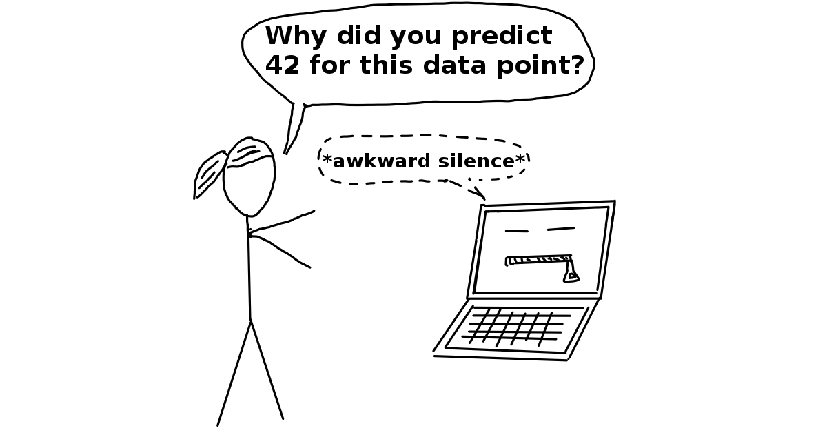
Definitions
Interpretable Machine Learning
Methods and models that make the behaviour and predictions of machine learning systems understandable to humans
Black-Box Systems
Models that cannot be understood by looking at their parameters
These models are not interpretable

Slide 47
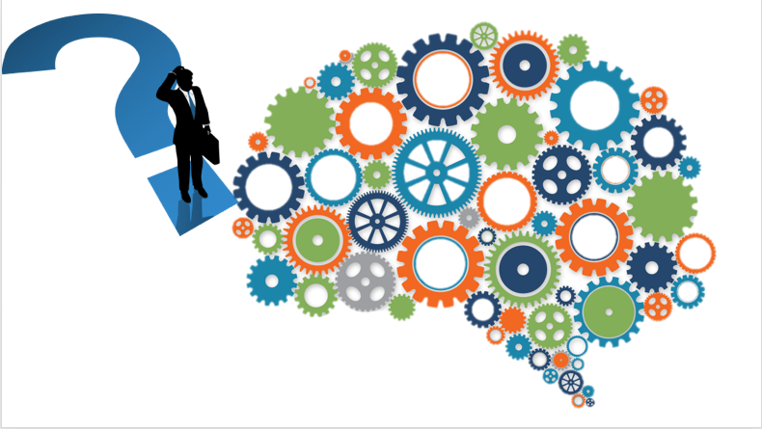
Definitions
Image Source: https://towardsdatascience.com
Interpretability
The degree to which a human can understand the cause of a decision
The degree to which a human can consistently predict the model’s result
A model is more interpretable than another model if its decisions are easier for a human to comprehend than decisions from the other model

Slide 48

Definitions
What is an explanation?
An explanation is the answer to a why-question
E.g., Why did not the treatment work on the patient
Properties of good explanations
Selective
Contrastive
Focus on the abnormal
Truthful
General and probable
Align with our prior beliefs

Slide 49
Overview
Image Source: https://www.linkedin.com
Definitions
Importance of Interpretability
Taxonomy of Methods
Interpretable Models
Model-Agnostic Methods
Example-based Explanations
Neural Network Interpretation
Where to next?

Slide 50


Importance of Interpretability
Image Source: https://www.oreilly.com/
Incomplete Descriptions
A single-value evaluation metric, such as accuracy, is an incomplete description of most real-world tasks
Incomplete Problem Formalisation
For certain problems a correct prediction only partially solves the original problem
I.e., in medical applications
For these tasks the model must also explain how it came to the prediction

Slide 51
Importance of Interpretability
Gain Knowledge
The goal of science is to gain knowledge
Many ML problems are solved with big datasets and black box machine learning models.
The model itself becomes the source of knowledge instead of the data.
Interpretability makes it possible to extract this additional knowledge captured by the model.

Slide 52
Importance of Interpretability
Health and Safety
Machine learning models take on real-world tasks that require safety measures and testing.
We need to be sure such systems are error free
As an example, consider a self-driving car automatically detects cyclists based on a deep learning system.
The explanation reveals that the most important learned feature is to recognize the two wheels of a bicycle
This explanation reveals edge cases like bicycles with side bags that partially cover the wheels

Slide 53
Importance of Interpretability
Detecting Biases
ML models pick up biases from the training data
E.g., a machine learning model for automatic approval or rejection of credit applications could discriminates against a minority group
This is an incompleteness of the problem formulation case
The factor you want to minimise is optimised by the loss function
Avoiding biases needs to be included as additional constraints
Interpretability can aid detecting biases in a model

Slide 54
Importance of Interpretability
Easier Debugging and Auditing
Fairness: Ensuring that predictions are unbiased and do not implicitly or explicitly discriminate against protected groups.
Privacy: Ensuring that sensitive information is protected
Reliability or Robustness: Ensuring that small changes in the input do not lead to large changes in the prediction.
Causality: Check that only causal relationships modelled
Trust: It is easier for humans to trust a system that explains its decisions compared to a black box

Slide 55


Importance of Interpretability
Image Source: https://towardsdatascience.com
Interpretability is not always needed
Interpretability is not required if the model has no significant ‘real-world’ impact
E.g., Recommender systems
Interpretability is not required when the problem is well studied
E.g., Handwritten digit recognition
Interpretability might enable people or programs to manipulate the system

Slide 56
Overview
Image Source: https://www.linkedin.com
Definitions
Importance of Interpretability
Taxonomy of Methods
Interpretable Models
Model-Agnostic Methods
Example-based Explanations
Neural Network Interpretation
Where to next?

Slide 57
Taxonomy of Interpretability Methods
Intrinsic or post hoc?
Is interpretability achieved by restricting the complexity of the machine learning model (intrinsic) or by applying methods that analyse the model after training (post hoc).
Intrinsic interpretability refers to machine learning models that are considered interpretable due to their simple structure, such as short decision trees or sparse linear models.
Post hoc interpretability refers to the application of interpretation methods after model training.

Slide 58
Taxonomy of Interpretability Methods
Differentiate models according to their results
Feature summary statistic: Methods which provide summary statistics for each feature
Feature summary visualization: visualisation of feature summary statistics
Model internals: visualisation of summaries of model internals e.g. learned weights
Data point: This category includes all methods that return data points to make a model interpretable.
Intrinsically interpretable model: Approximate black-box models with an interpretable model

Slide 59
Taxonomy of Interpretability Methods
Model-specific or model-agnostic?
Model-specific interpretation tools are limited to specific model classes.
Model-agnostic tools can be used on any machine learning model and are applied after the model has been trained
Local or global?
Does the interpretation method explain an individual prediction or the entire model behaviour

Slide 60
Overview
Image Source: https://www.linkedin.com
Definitions
Importance of Interpretability
Taxonomy of Methods
Interpretable Models
Model-Agnostic Methods
Example-based Explanations
Neural Network Interpretation
Where to next?

Slide 61

Interpretable Models
Image Source: https://towardsdatascience.com
Interpretable Models
Achieve interpretability by restricting the complexity of the machine learning model

Slide 62

Interpretable Models
Linear Regression
Advantages
Transparent how predictions are produced
Regularisation can be used to limit number of weights
Easy to use
Disadvantages
Can only represent linear relationship
Poor predictive power
$$y=β_{0}+β_{1}x_{1}+…β_{n}x_{n}+∈$$

Slide 63

Interpretable Models
Logistic Regression
Advantages
Returns a probability
Easy to use
Disadvantages
Poor predictive power
Complete separation. If there is a feature that can perfectly separate the two classes, the model can not be trained
$$P(y=1)=\frac{1}{1+exp⁡(−(β_{0}+β_{1}x_{1}+…β_{n}x_{n}))}$$

Slide 64

Interpretable Models
Decision Tress
Split the data multiple times according to certain cut-off values in the features
Advantages
Capture interactions between features in the data.
Provide natural visualization, via nodes and edges.
Create good explanations
Disadvantages
Not effectives when estimating linear relationships
Unstable – changes in training data, changes entire tree structure
Weak classifier
$$y=\sum_{m=1}^{M}{c_{m}I\left\{xεR_{m}\right\}}$$

Slide 65
Overview
Image Source: https://www.linkedin.com
Definitions
Importance of Interpretability
Taxonomy of Methods
Interpretable Models
Model-Agnostic Methods
Example-based Explanations
Neural Network Interpretation
Where to next?

Slide 66

Model-Agnostic Methods
Separating the explanations from the machine learning model
Main advantage of this approach is flexibility
Interpretation methods can be applied to any model
Greater predictive performance
Complex models can still be used
Allows for easier comparisons
Same explanation method can be applied to all models under consideration

Slide 67

Model-Agnostic Methods
Image Source: https://www.oreilly.com/
What makes a good Model-Agnostic Method?
Model flexibility: The method can work with any machine learning model, i.e., random forests through to DNNs
Explanation flexibility: The system is not limited to a certain form of explanation
Representation flexibility: The system should be able to use a different feature representation to the model being explained

Slide 68
Model-Agnostic Methods
Wide array of possible approaches
Partial Dependence Plots
Determines the relationship between a small number of input variables and predictions. They show how the predictions partially depend on values of the input variables of interest
Individual Conditional Expectation Plots
Explore individual differences and identify subgroups and interactions between model inputs
Accumulated Local Effects Plots
Describe how features influence the prediction of a machine learning model on average

Slide 69
Local Interpretable Model-Agnostic Explanations
Local Interpretable Model-Agnostic Explanations (LIME)
Trains local surrogate models to approximate the predictions of the underlying black box model
LIME tests what happens to the predictions when you give variations of your data into the machine learning model
It generates a new dataset consisting of permuted samples and the corresponding predictions of the black box model
Lime uses this new dataset to train an interpretable model

Slide 70
Local Interpretable Model-Agnostic Explanations
Key steps in LIME
Trains your (black-box) model
Select your instance of interest you wish to explain
Perturb your dataset and get the predictions for these new points.
Train a weighted, interpretable model on the dataset with the variations
The weights are based on the new samples according to their proximity of perturb instance to the original
Explain the prediction by interpreting the local mode

Slide 71

Local Interpretable Model-Agnostic Explanations
Image Source: https://www.oreilly.com/
Example: Google's Inception neural network
Learn a simple (linear) model on this data set
For each perturbed instance, we get the probability that a tree frog is in the image according to the model
Explanation consists of identifying the instances in the feature space with highest positive weights

Slide 72


Local Interpretable Model-Agnostic Explanations
Image Source: https://www.oreilly.com/
Example: Google's Inception neural network
The explanation reveals that the classifier primarily focuses on the frog's face as an explanation for the predicted class
It also indicates why "pool table" and “red balloon” returned a non-zero probability

Slide 73
Local Interpretable Model-Agnostic Explanations
Advantages of LIME
You can replace the underlying machine learning model, and still use the same local, interpretable model for explanations
Use simple local models to make human-friendly explanations
Easy to use, implemented in Python and R
Disadvantages of LIME
Gaussian sampling use to perturb data instance
Potentially instable explanations
Not a global approach, maybe insufficient in certain senarios

Slide 74
Overview
Image Source: https://www.linkedin.com
Definitions
Importance of Interpretability
Taxonomy of Methods
Interpretable Models
Model-Agnostic Methods
Example-based Explanations
Neural Network Interpretation
Where to next?

Slide 75
Example-Based Explanations
Example-based Explanations
Select particular instances of the dataset to explain the behaviour of machine learning models
Can also be used to explain the underlying data distribution
The difference to model-agnostic methods is that the example-based methods explain a model by selecting data instances, not by creating summaries of features
Example-based explanations only make sense if we can represent an instance of the data in a humanly understandable way e.g., images

Slide 76
Example-Based Explanations
Common approaches include:
Counterfactual explanations: tell us how an instance has to change to significantly change its prediction.
Adversarial examples: are counterfactuals used to fool machine learning models.
Prototypes and Criticisms: selection of either well (prototypes) or not well (criticism) representative instances
Influential instances: training data points that were the most influential for the parameters of a prediction model
k-nearest neighbours model: An (interpretable) machine learning model based on examples.

Slide 77
Example-Based Explanations
Adversarial Examples
An instance with small, intentional feature perturbations that cause a machine learning model to make a false prediction
The aim to deceive the model, not interpret it
Knowledge of adversarial examples is important as they make machine learning models vulnerable to attacks
Most adversarial approaches minimise the distance between the adversarial example and the instance to be manipulated, while shifting the prediction to the desired outcome
Highly active area of neural network research

Slide 78



Example-Based Explanations
The fast gradient sign method
Adversarial Methods
One pixel Attack
The Adversarial patch

Slide 79
Overview
Image Source: https://www.linkedin.com
Definitions
Importance of Interpretability
Taxonomy of Methods
Interpretable Models
Model-Agnostic Methods
Example-based Explanations
Neural Network Interpretation
Where to next?

Slide 80
Neural Network Interpretation
Deep Learning system are complex
A single prediction can involve millions of mathematical operations, depending on the network architecture
Interpretation is virtually impossible
We would have to consider millions of weights that interact in a complex way to understand a prediction by a neural network
Standard explanation methods can work, however specific neural-network based approaches are advantageous
Access learnt information in hidden layers
Utilise the gradient of the network

Slide 81

Neural Network Interpretation
Feature Visualisation
Major advantage of DNN’s is that they automatically learn high-level features in the hidden layers
CNN’s learn increasingly complex features in their layers
The first layer(s) learn features such as edges and simple textures.
Later layers learn more complex textures and patterns.
The last layers learn features such as objects or parts of objects.

Slide 82


Neural Network Interpretation
Feature Visualisation
Approaches of making the learned features explicit
Finding the input that maximizes the activation of a unit
Unit: neurons, entire feature maps, entire (convolutional) layers
Feature visualisation is an optimisation problem
Assume that the weights of the neural network are fixed
I.e., the network is trained.
We are looking for a new image that maximizes the (mean) activation of a unit:
$${img}^{ ∗}=arg \max_{img}{\sum_{x,y}{h_{n,x,y,z}\left(img\right)}}$$
Equation identifies mean activation of an entire channel $z$ in layer $n$

Slide 83



Neural Network Interpretation
Feature Visualisation
Instead of maximizing the activation, you can also minimize the activation
Maximising
Minimising
$${img}^{ ∗}=arg \max_{img}{\sum_{x,y}{h_{n,x,y,z}\left(img\right)}}$$
$${img}^{ ∗}=arg \min_{img}{\sum_{x,y}{h_{n,x,y,z}\left(img\right)}}$$
Activations from Inception V1 neuron 484 from layer mixed4d pre Relu

Slide 84

Neural Network Interpretation
Key steps in Feature Visualisation
Start from random noise
Place constraints on the update
Ensure that only small changes are allowed
Apply steps to reduce noise in updates
Jittering, rotation or scaling to the image

Slide 85
Neural Network Interpretation
Advantages of Visualisation
Unique insights into the learning process of neural networks
Can be used to explain which pixels were important for the classification
Disadvantages of Visualisation
Many feature visualization images are simply not interpretable
Illusion of explainability
They offer no real insight into the working of the neural network
The neurons interact in a highly complex manner, we still cannot infer these interactions from observing when certain neurons activate

Slide 86
Overview
Image Source: https://www.linkedin.com
Definitions
Importance of Interpretability
Taxonomy of Methods
Interpretable Models
Model-Agnostic Methods
Example-based Explanations
Neural Network Interpretation
Where to next?

Slide 87
Where to next?
Think about interpretability early on in system design
Do we really need a learning model to make the decisions and an explanation model to provide explanations?
Greater trust in just having the one system
Current dilemma:
Blackbox models cannot be avoided because the problems we want to solve are complex and non-linear.
If simpler models were used, there will be a trade-off in performance (for explainability) which we don’t want
Solution: incorporate explainabiltiy into design of AI solution

Slide 88

Where to next?
Image Source: https://towardsdatascience.com
Think about explanations early
Know what explanations are desired
Close collaboration of all stake-holders
Incorporate this into system design
Design the architecture of the learning method to give intermediate results that pertain to these explanations
Goal of explainable AI should not be to create AI that explains itself, rather to create AI that does not need to

